Slide 1
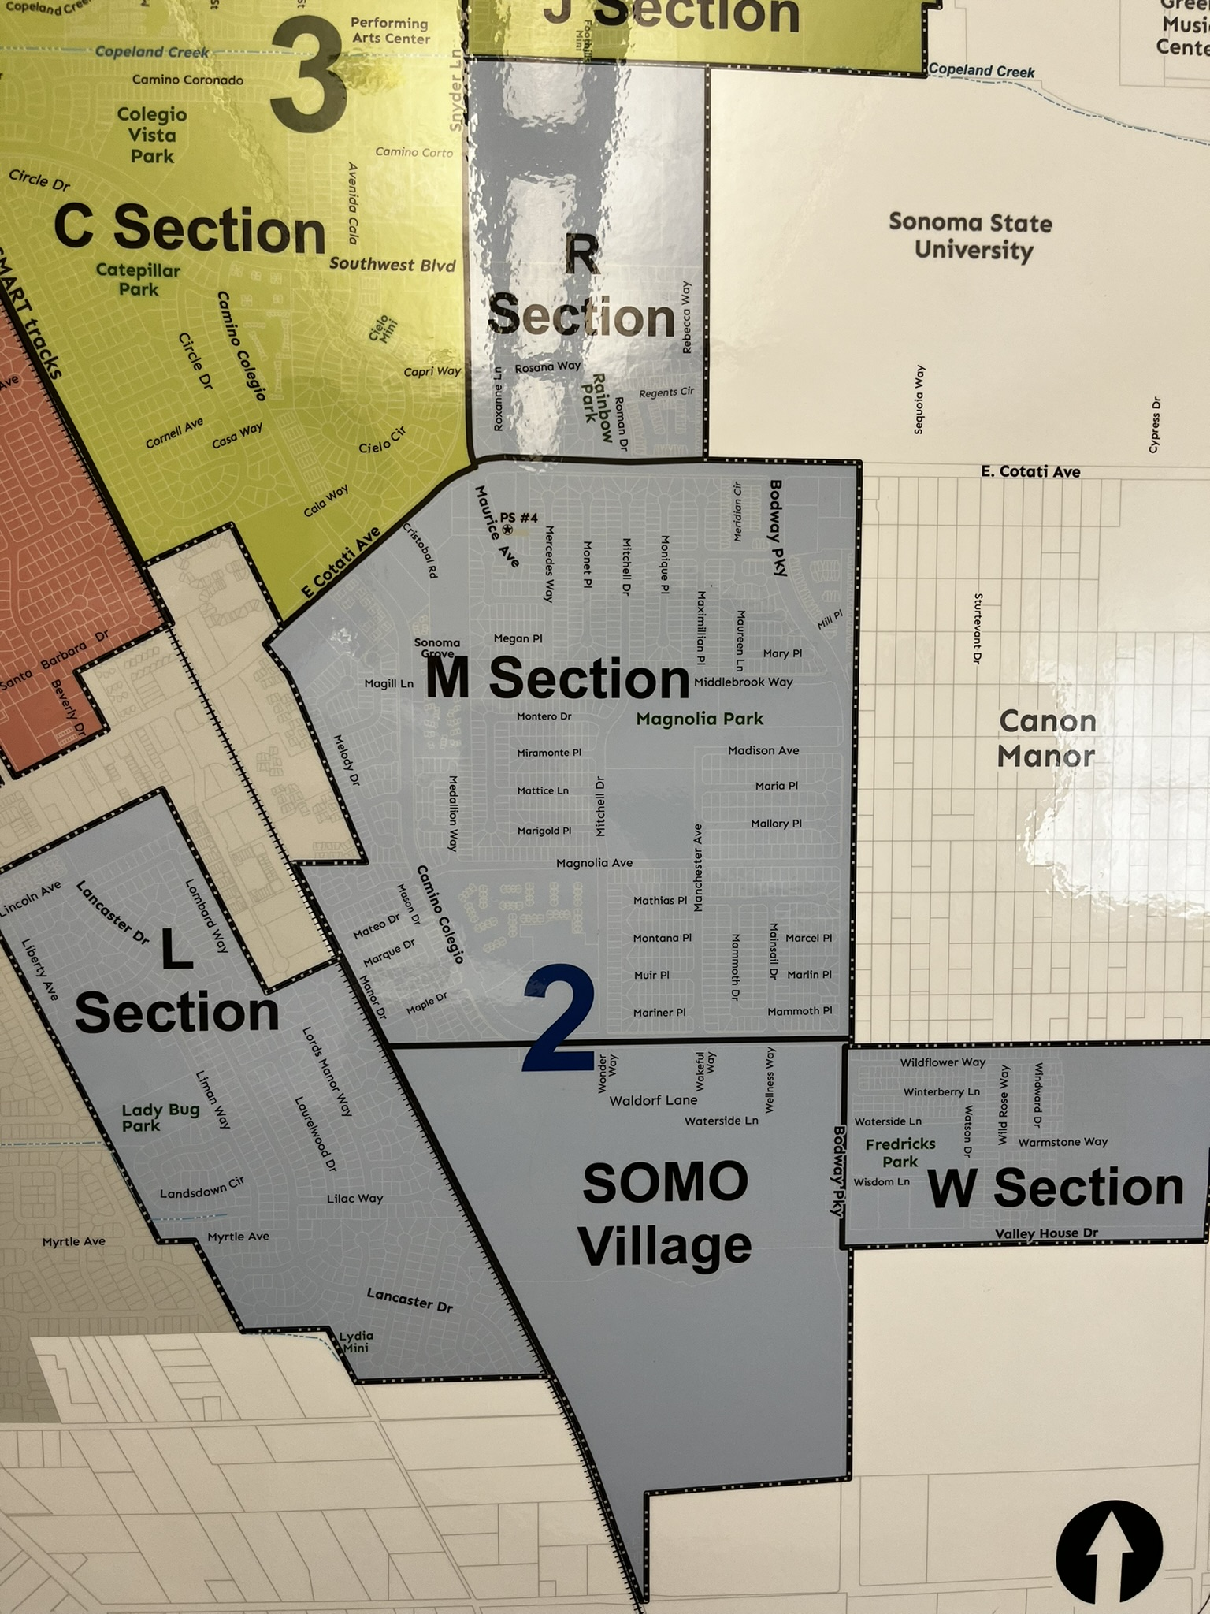
District 2 (L, M, R, W) Neighborhood Meeting
Hosted by: Councilmember Emily Sanborn
November 7, 2023

Slide 2
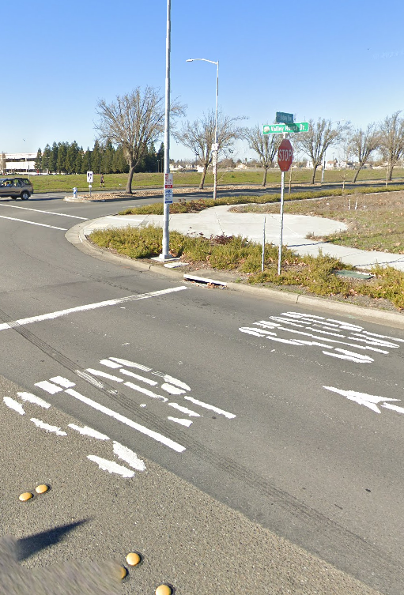
Bodway/Camino Colegio/Valley House
Traffic
10/30/2023

Slide 3
Guiding Question
Can the City produce a proactive approach regarding speeding and pedestrian safety to respond to a resident’s request to install a Stop Sign at the intersection of Camino Colegio and Bodway?

Slide 4
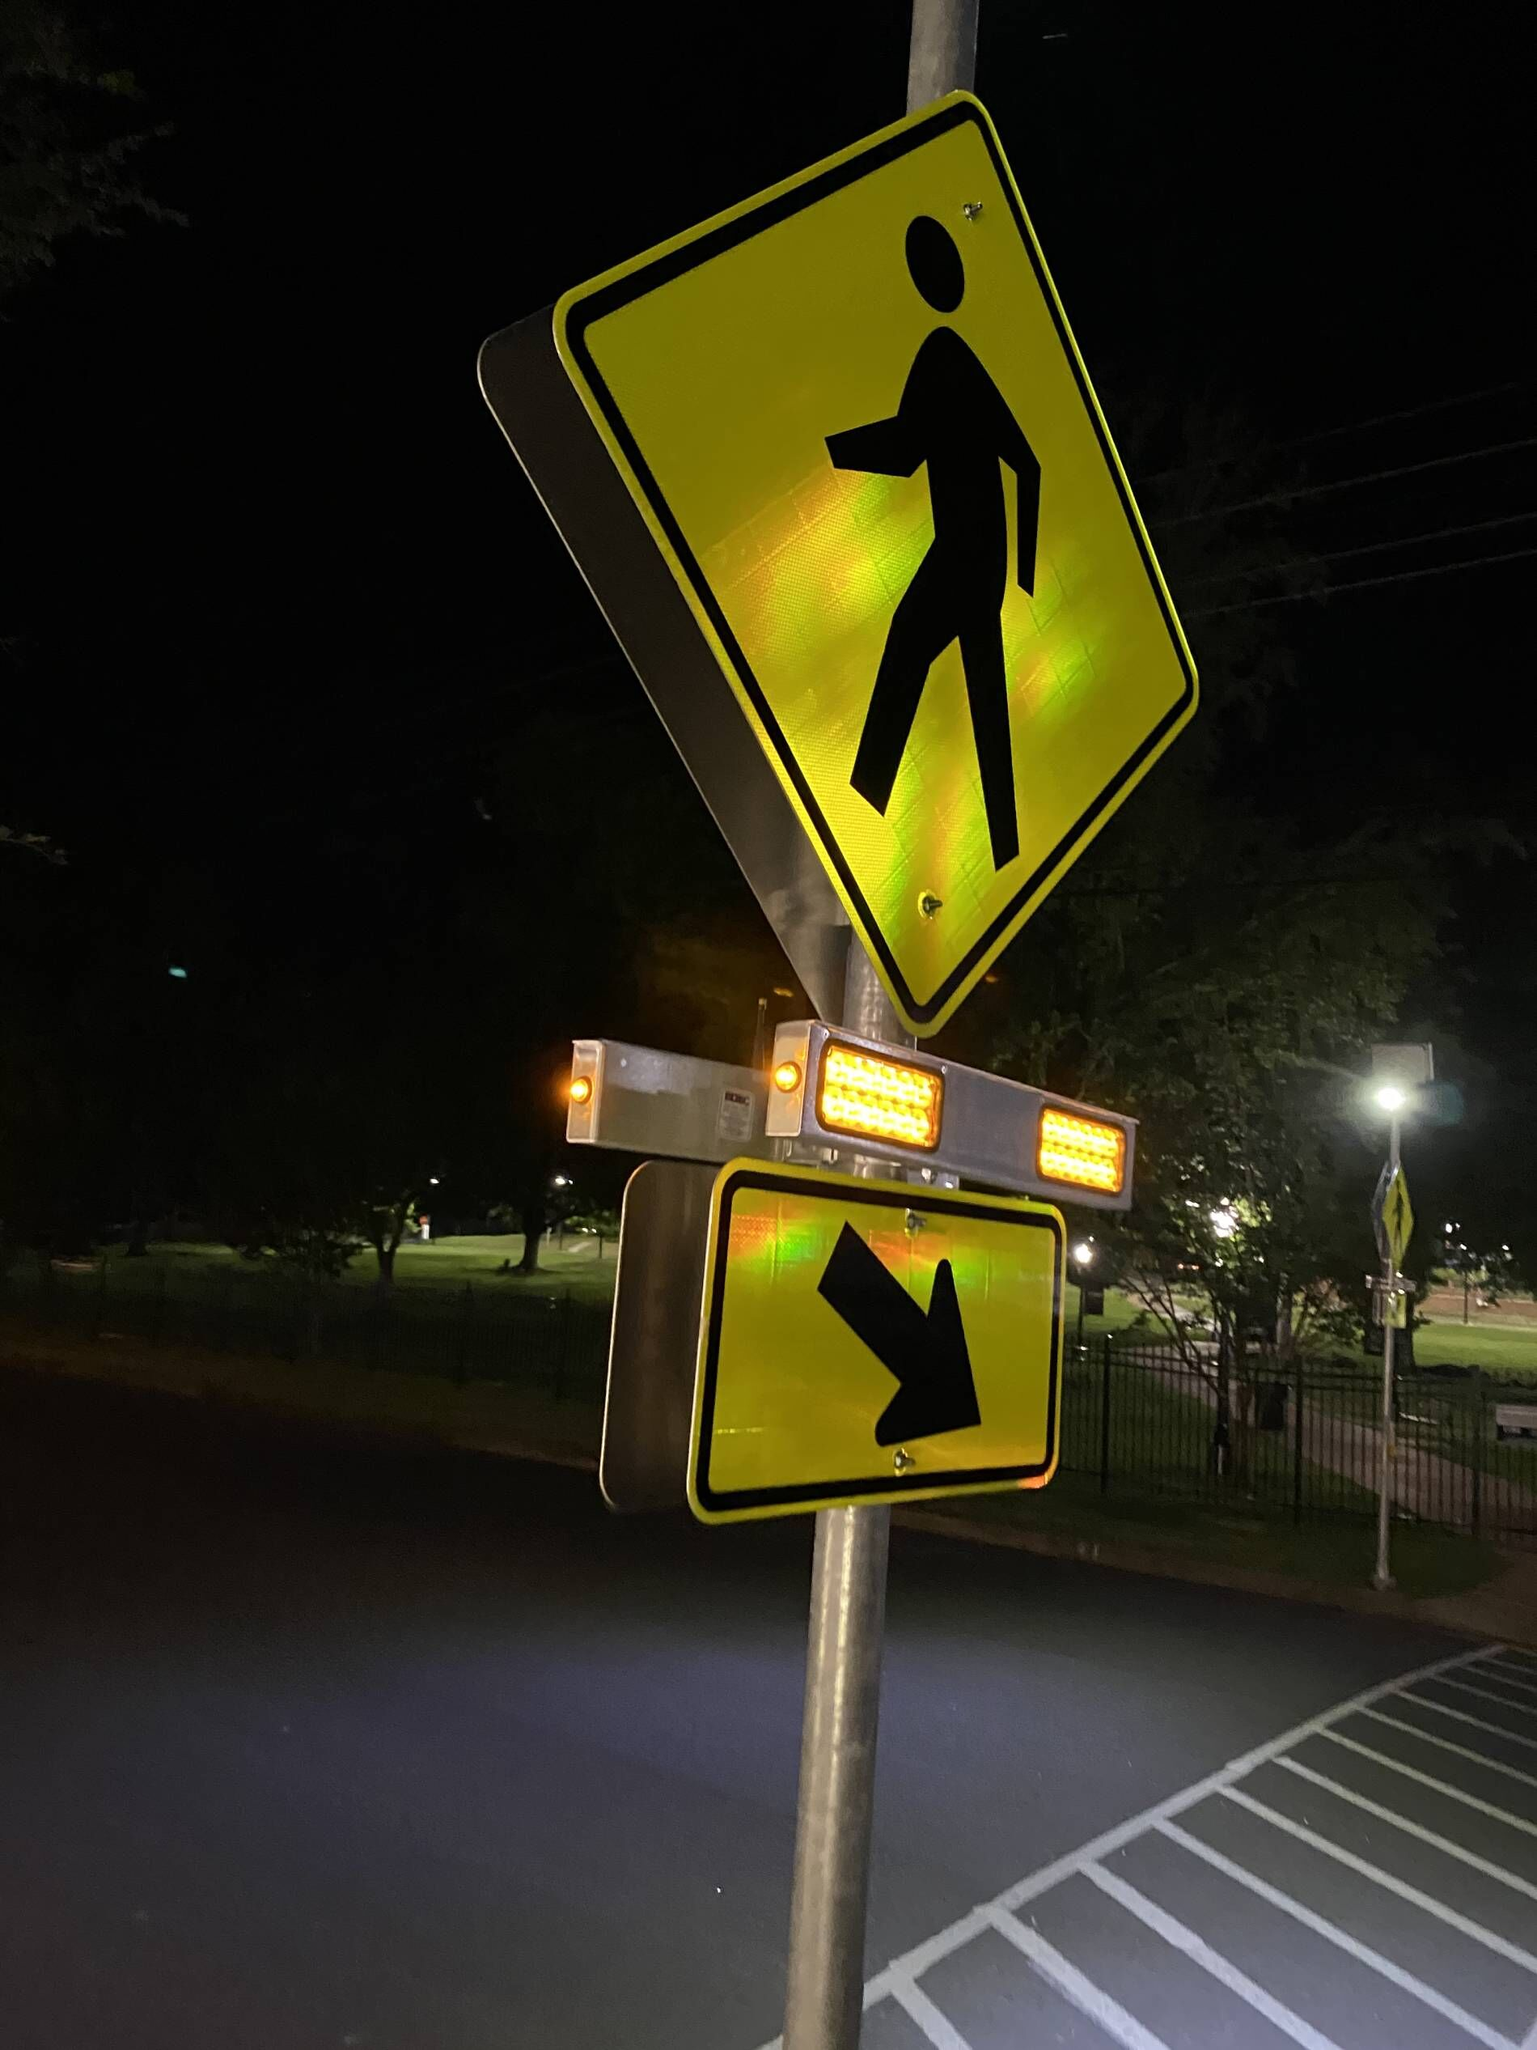
Previous Work Completed
March 17, 2023 – City replaced developer installed lighted pedestrian crossing with a Rectangular Rapid-Flashing Beacon (RRFB)
  Why?
    RRFBs are particularly effective at multilane crossings with speed limits less than 40 mph.
    Research indicates RRFBs can result in motorist yielding rates as high as 98 percent at marked crosswalks.
    Developer installed pedestrian crossing was not well lit
March 17, 2023 – City Removed Center Median trees on Bodway
  Why?
    To improve visibility at the intersection of Bodway and Camino Colegio

Slide 5
Why Can’t We Put a Stop Sign @ Bodway/Camino Colegio
Does not meet the threshold for a Stop Sign per CA MUTCD requirements
  There have only been 3 collisions in a 7-year (2016-2023) period (MUTCD standard is 5 crashes per 1 year).
  Speed limit is 35…average speed was measured at 36 with 41 as the highest average (only 6 mph over)
Placing a stop sign where one is not needed is not legally enforceable.
  Because the intersection does not meet the CA MUTCD threshold, there is a potential for someone taking legal action if they receive a speeding ticket/stop sign ticket.
Placing a stop sign where one is not needed also sets a bad City precedent
  Anyone who believes speeding is an issue would demand to have a stop sign
  Would require a lot of time and money to do this for every resident who thought a stop sign was warranted in their respective location.
Stop Signs are not meant to be speed control; they are used to control right of way

Slide 6
Potential Solutions
The City can start exploring these potential solutions to the speeding and pedestrian safety complaint at Bodway/Camino Colegio.
These ideas will need to be fleshed out to determine the most effective and efficient solution.

Slide 7
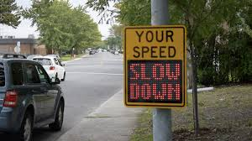
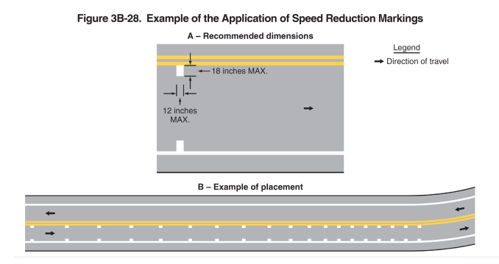
Potential Solutions
Adding a “this is your speed” radar device.
  A temporary one can be installed
  Recommend a permanent solar powered device for permanent installation
  Set the blinking threshold at 36, set the red and blue lights (slow down) at 40 mph
Conduct a “line of sight” study to determine if trees need to be trimmed to improve driver visibility
Add “Speed Reduction Markings”
  A pattern of progressively reduced spacing to give drivers the impression that their speed is increasing
  HOWEVER – guidance states “speed reduction markings should not be used on long sections of roadway or in areas frequented by local drivers”

Slide 8
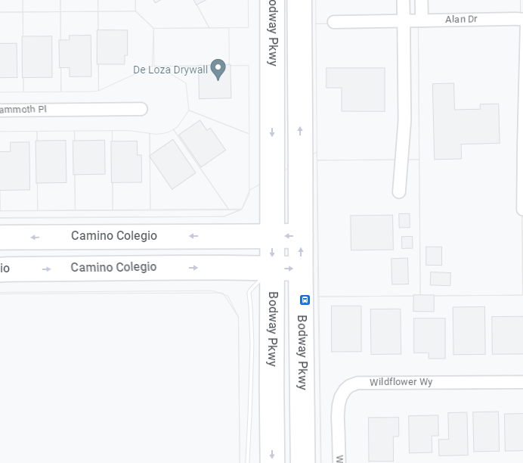


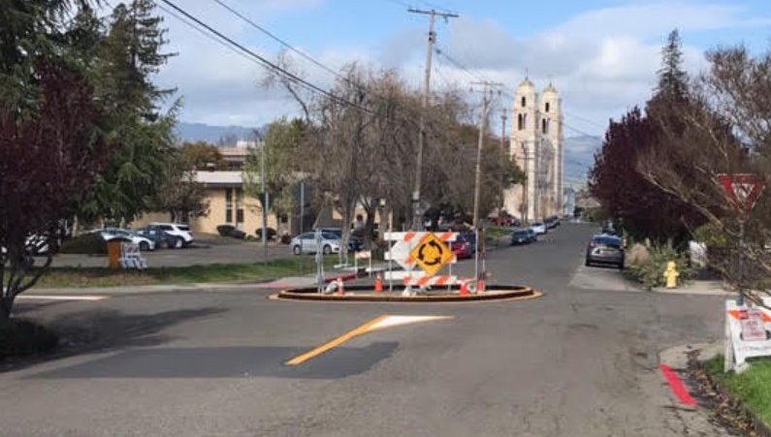
Potential Solutions
Add yellow flashing lights for North/Southbound traffic on Bodway
  Yellow lights would turn on when vehicle pulls up to Camino Colegio stop sign
Roundabout installation at Valley House/Bodway
  Already designed, will be paid for by SOMO.
Roundabout installation at Bodway/Camino Colegio
  Was previously looked at, needs funding
  Interim solution – We can stripe and add a curb for an inexpensive roundabout (Petaluma shown)
Vehicle trips yellow light

Slide 9
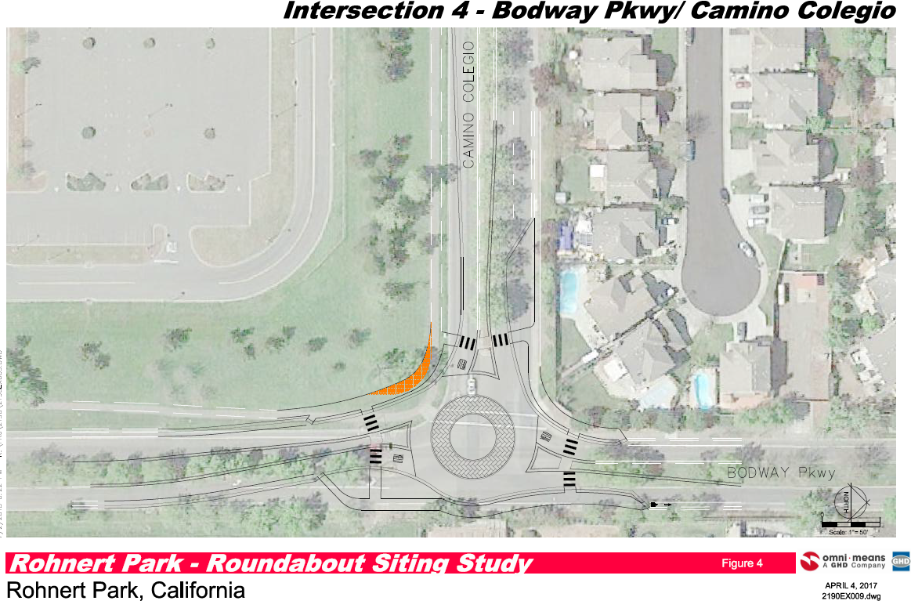

Slide 10
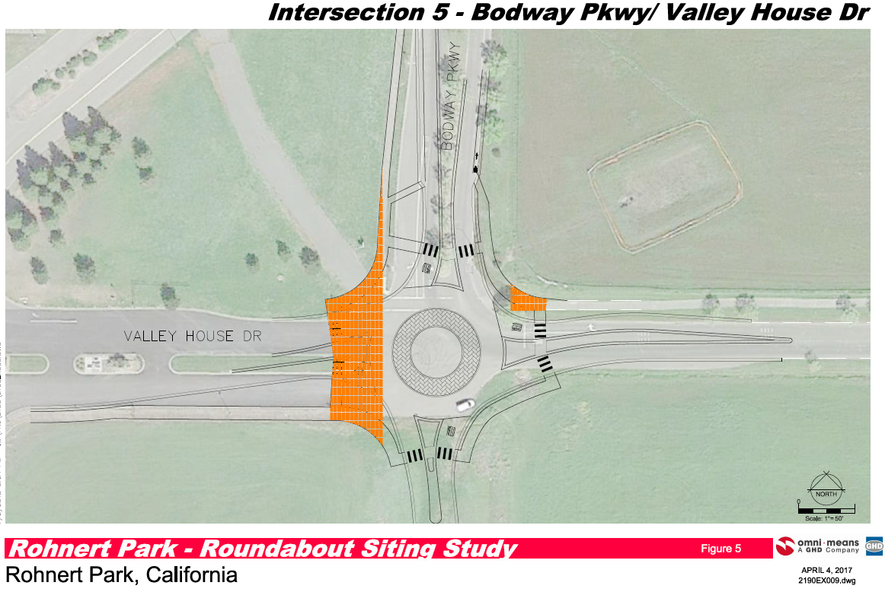

Slide 11

Questions?

Slide 12
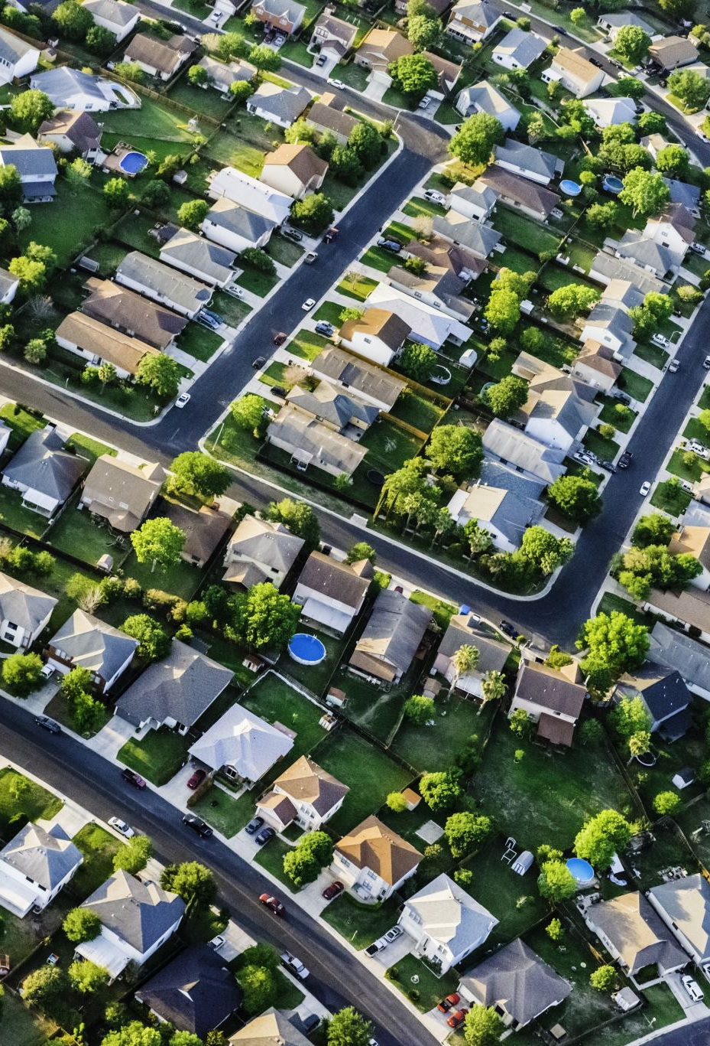
Neighborhood Public Improvements
L, M, R, W Neighborhoods (District 2)

Slide 13
11 Projects happening in District 2 in calendar years 2023/2024!
$6 million in Improvements!
Projects happening throughout all of District 2:
-Water meter replacement project
-Parks and Recreation Master Plan

Slide 14
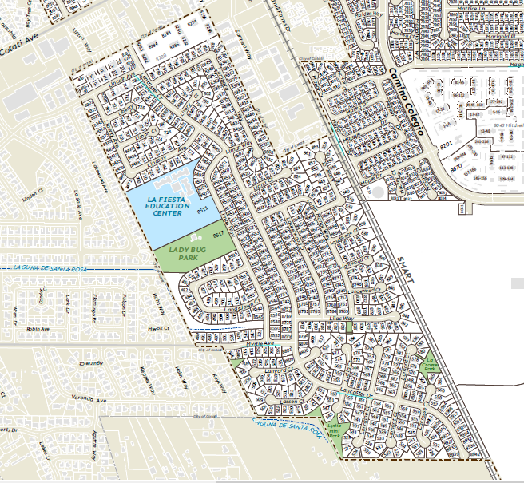
M and L Sections
Old Sewer Line Replacement (Lancaster/Lincoln)
M-Section Water Tank Rehab
Ladybug Park Pool Building Demolition
Lydia Park Playground Equipment Replacement

Slide 15
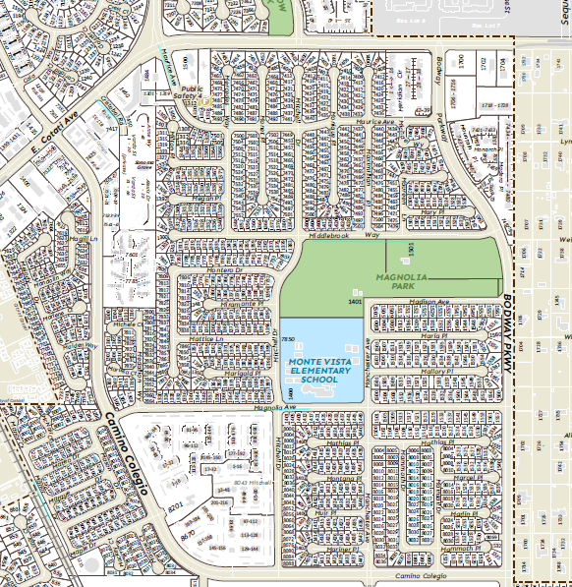
Magnolia Tennis Courts Recoating
M Section
Magnolia Pool Rehab
Sports Lighting Electrical Rehab and Lamp Replacement

Slide 16
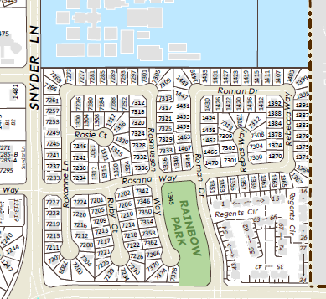
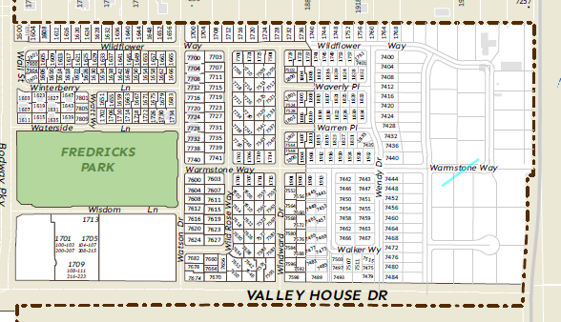
R and W Section
Rainbow playground fall material replacement

Slide 17
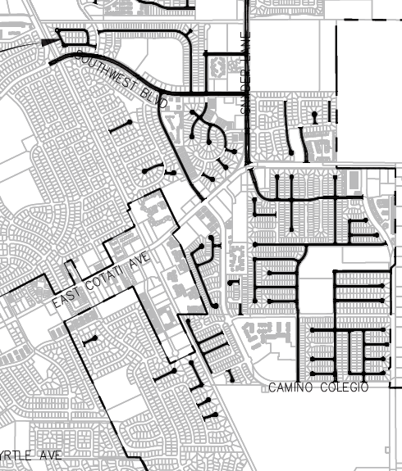

Slide 18

SOMO Village Update

Slide 19
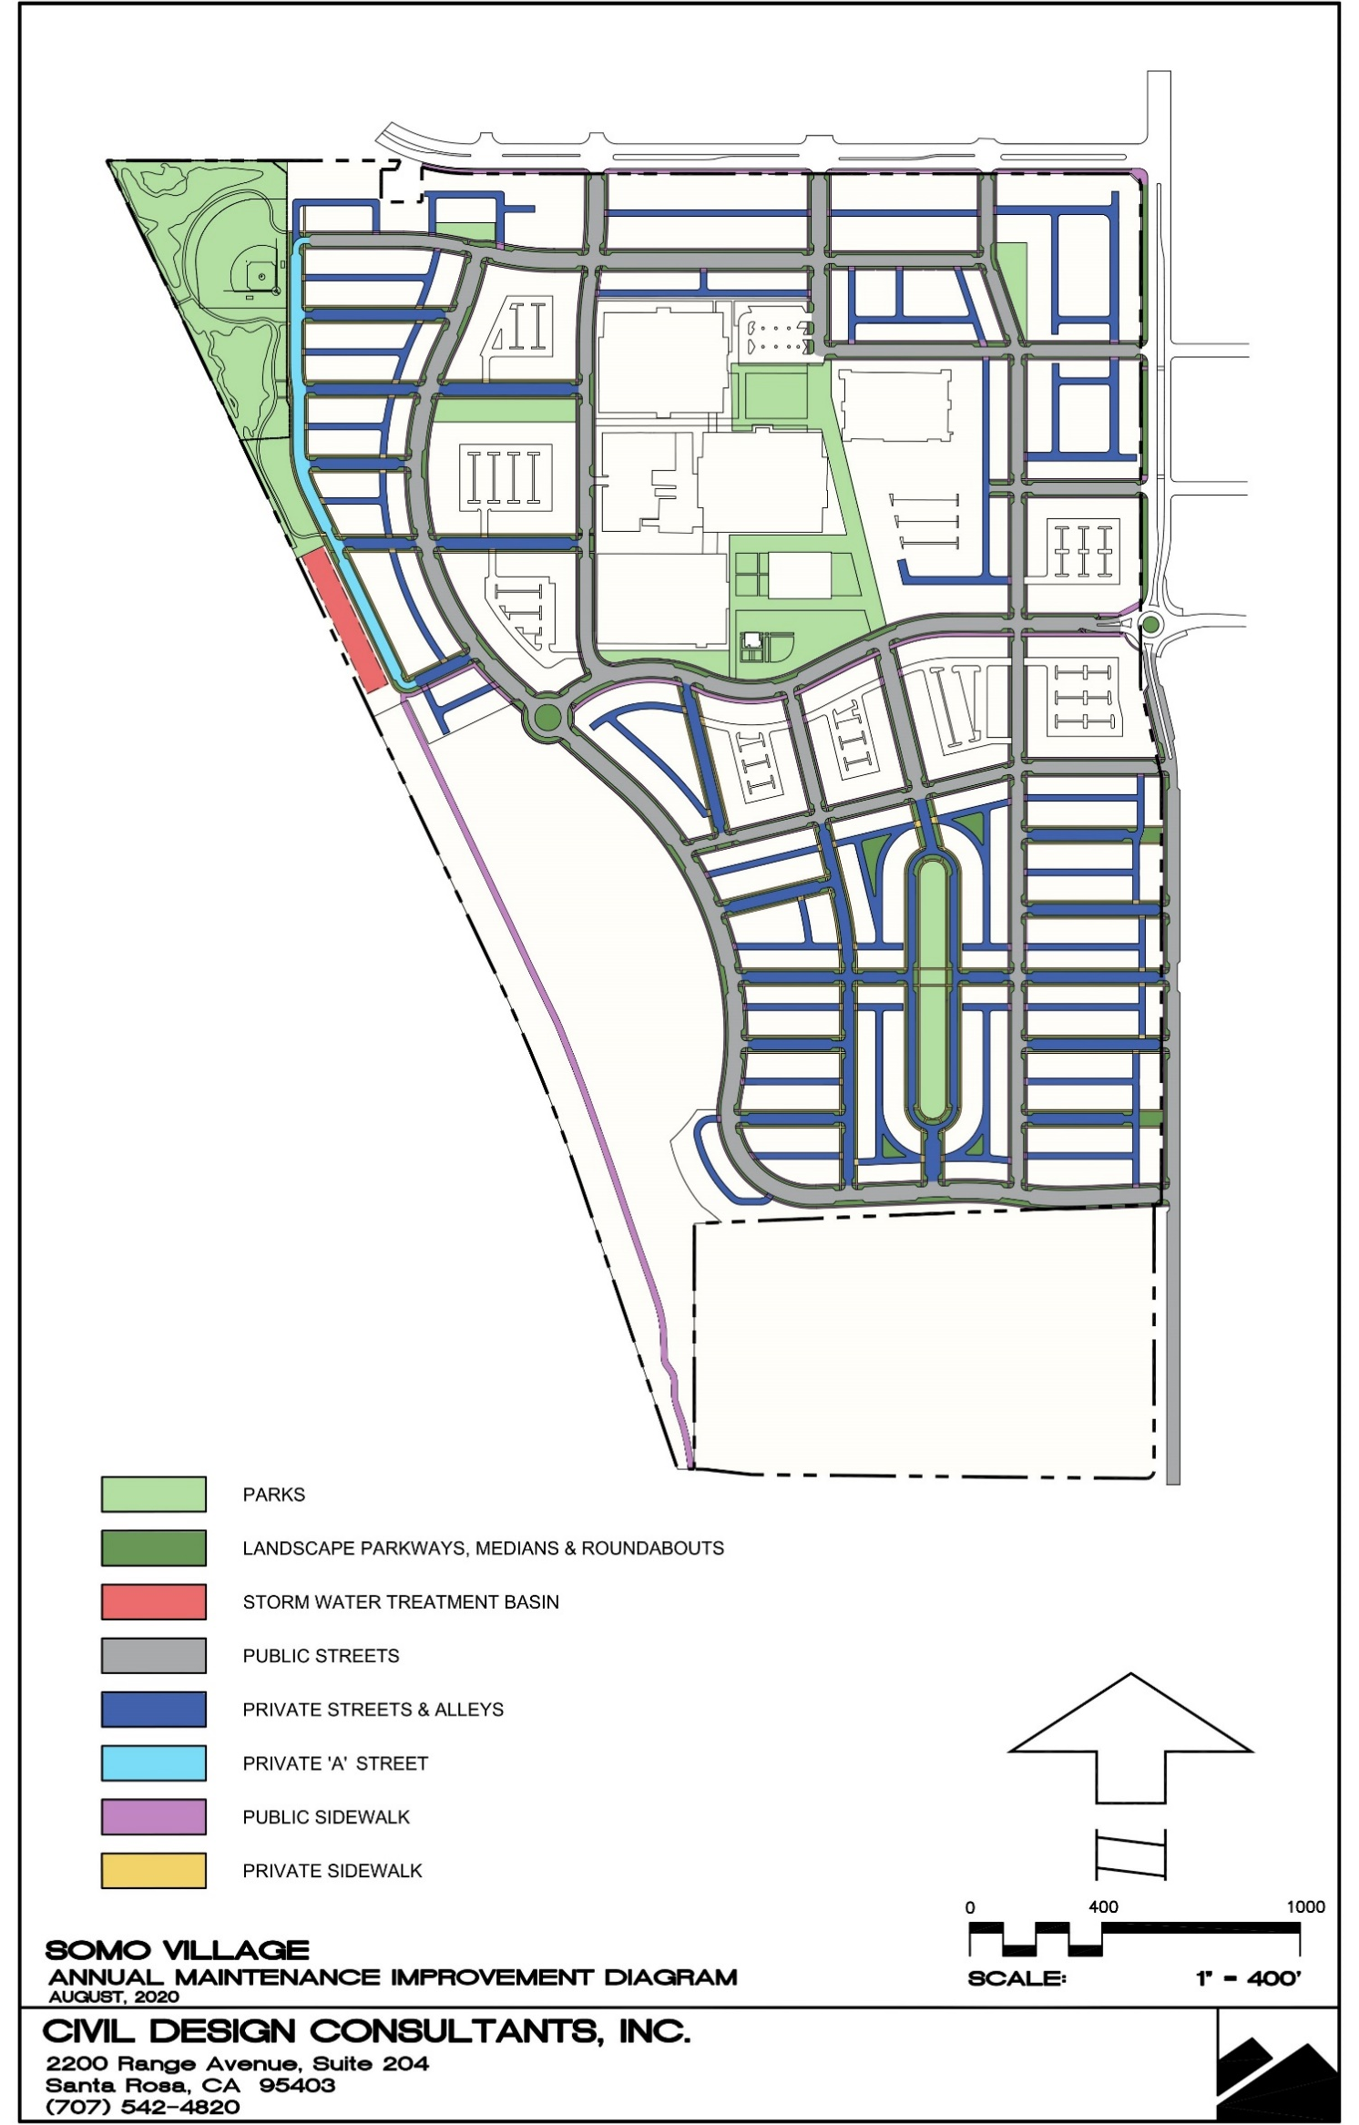
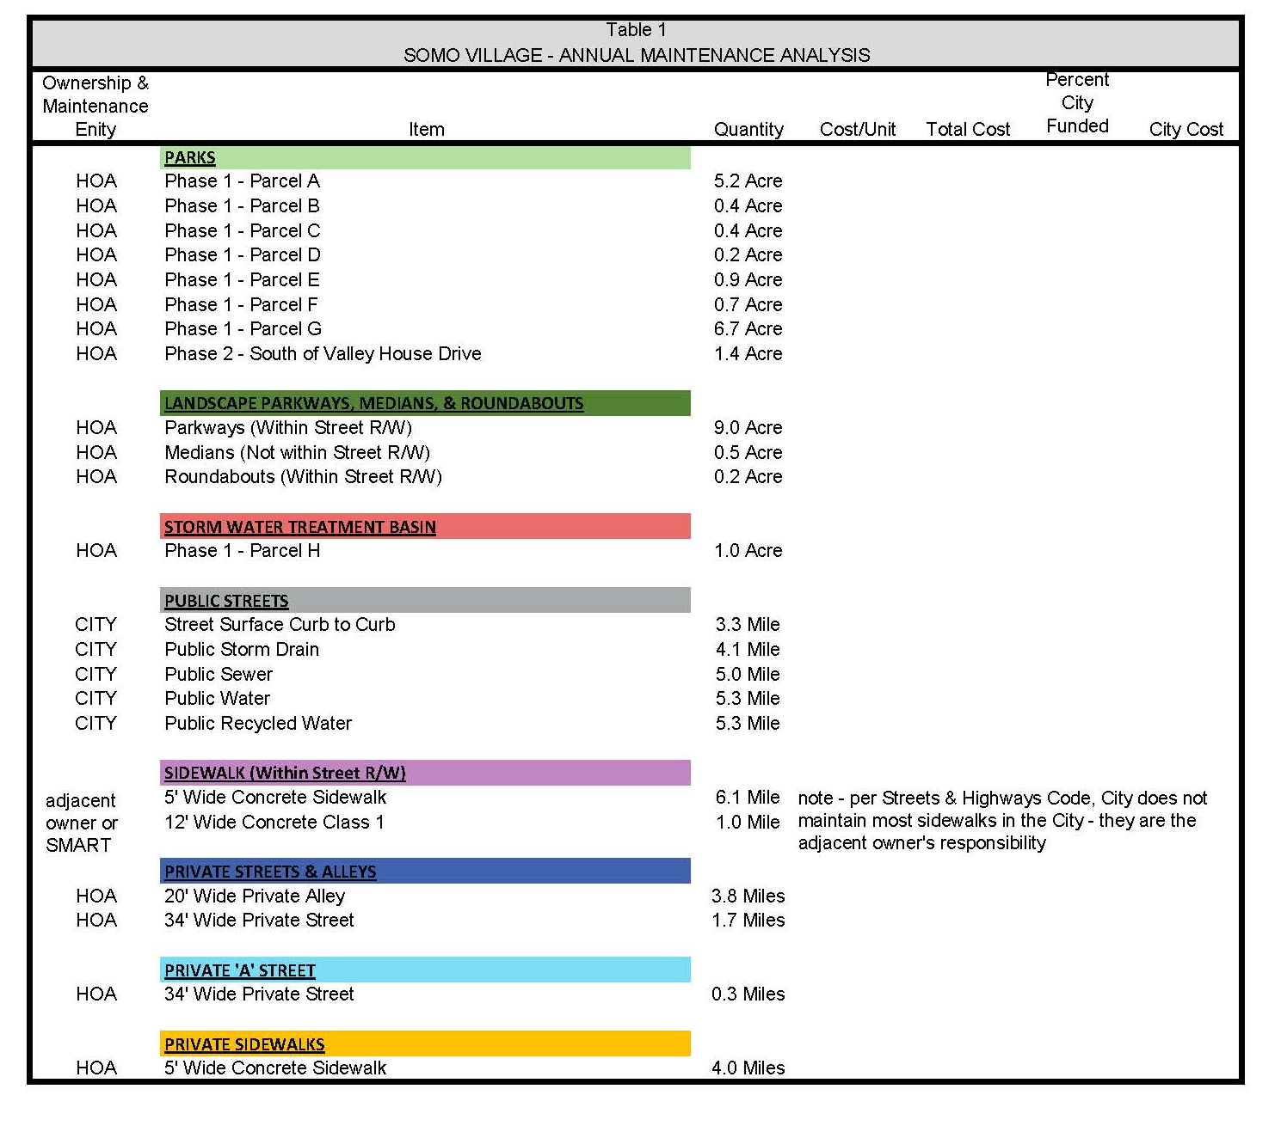

Slide 20
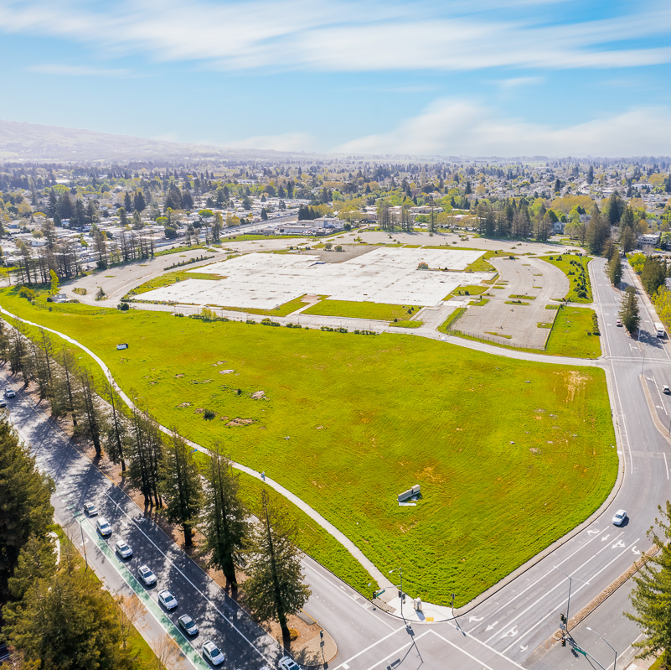
Downtown Rohnert Park Update
&
Request for Qualifications (RFQ) Highlights
October 24, 2023 - Council Meeting
Notes:
Good evening.

Slide 21
Background
City purchased 6400 State Farm Drive property in April 2022
Proactive actions have been taken to offer a “shovel ready” site
Established community-driven vision - walkable place with local restaurants, local shops, central plaza/square, pocket parks, and new housing opportunities
Extensive community outreach and valuable feedback has been obtained from various stakeholders
In December 2022, completed retail market analysis to assess retail feasibility (per study, site can support up to 65,000 sq. ft. of new retail and restaurant space – equating up to 30 new businesses)
Declared and certified property as “Exempt Surplus Land”
Formally rescinded previous development agreements and entitlements between City and previous developer
Special Designations: Site is within Priority Development Area and City has received Prohousing Designation (citywide); submitted application to MTC for consideration in Priority Sites Program – these programs competitively position City for funding opportunities

Slide 22
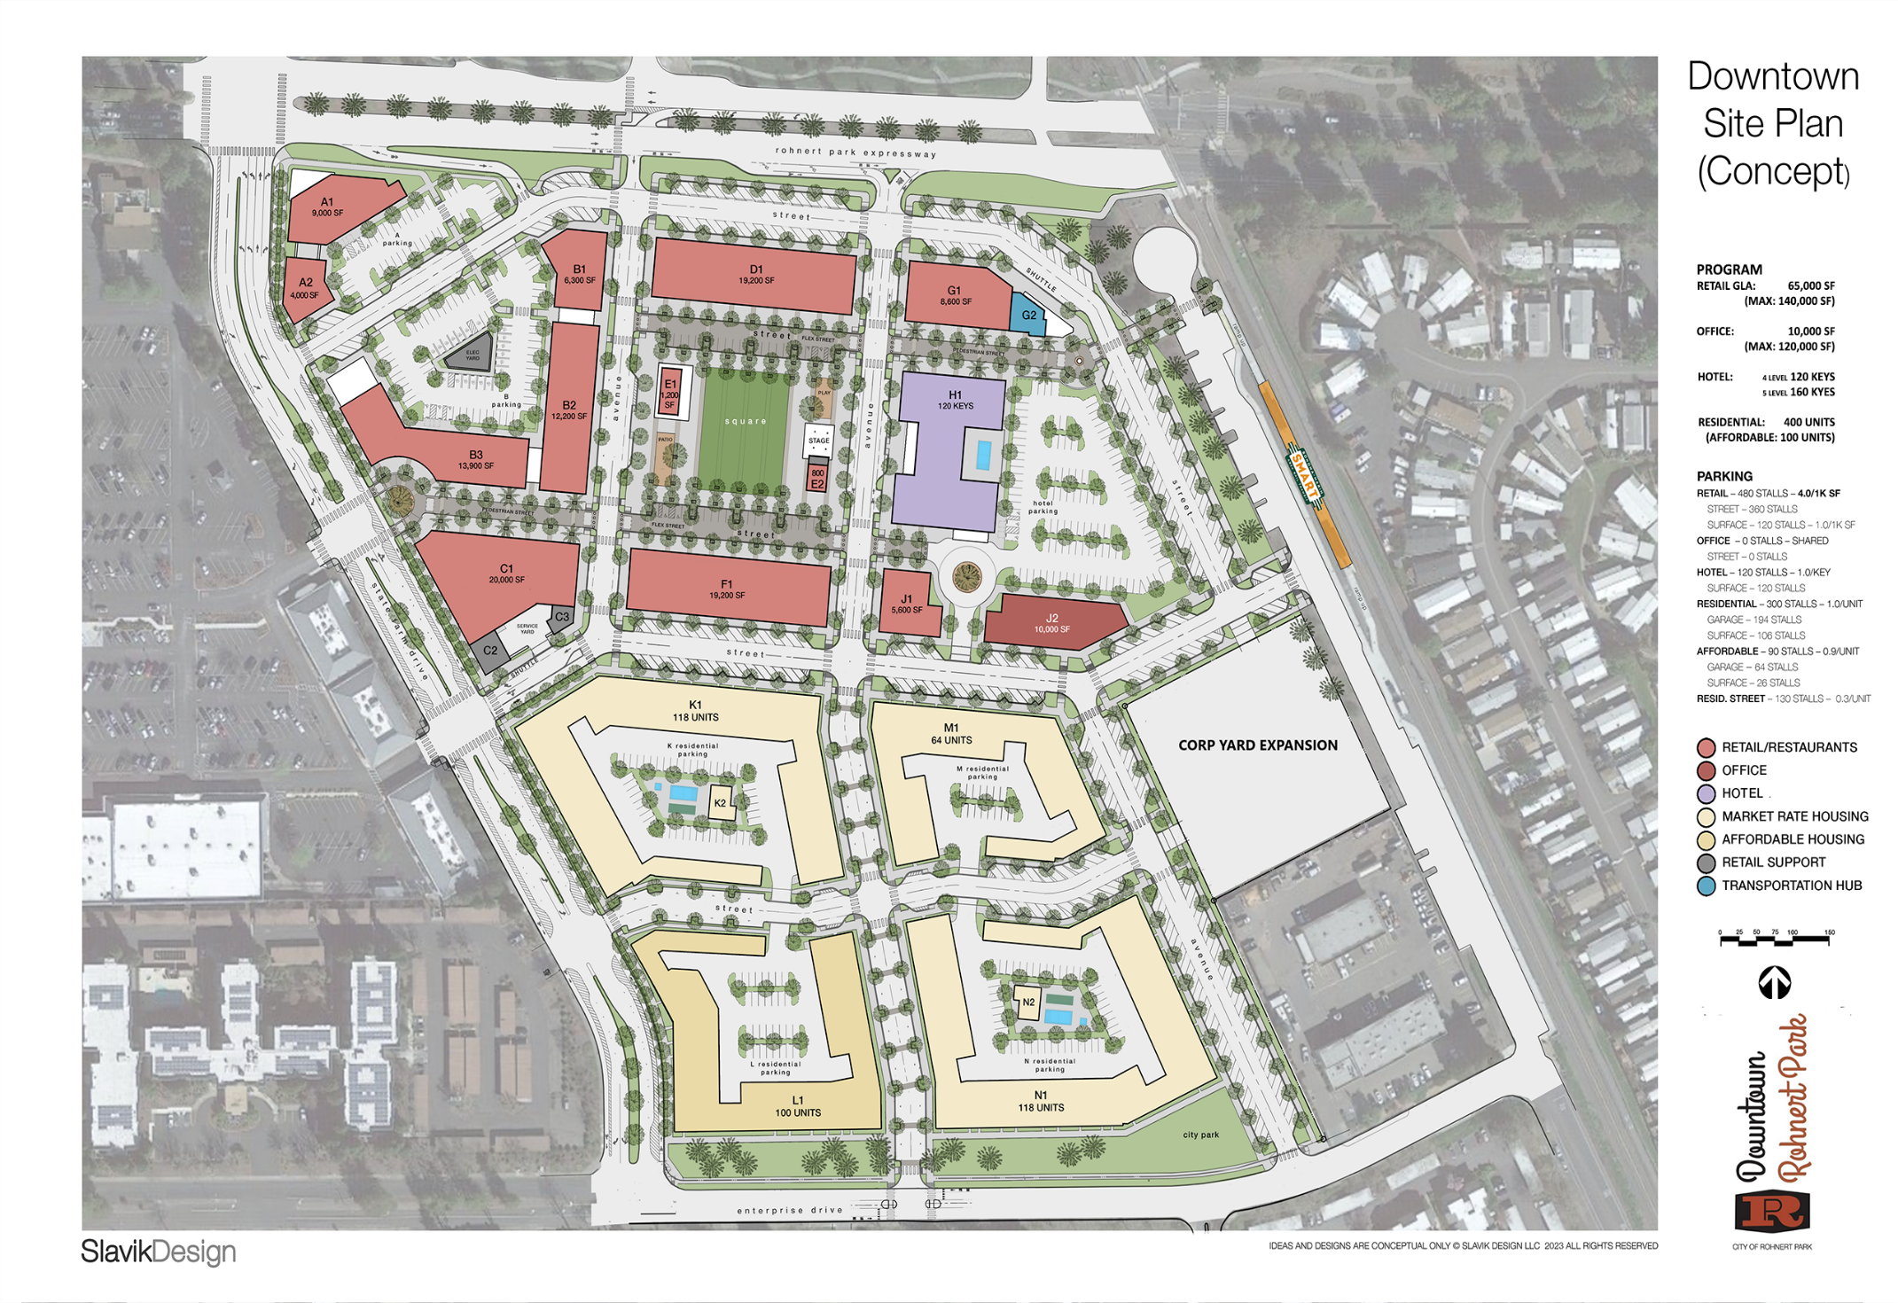
CONCEPTUAL SITE PLAN

Slide 23
Key Elements of Project Solicitation
Financial Requirements
Proposers must be able to:
--Develop the site
--Make substantial infrastructure improvements
--Address/mitigate impacts of development
--Operate/maintain a high-quality development
Selection Process
--Phase 1 - RFQ: statement of qualifications and a conceptual plan
--Short list selection of development entities
--Phase 2 - Interviews, discussion of conceptual land uses alignment with the City, project site visits by City representatives
--Phase 3 – Negotiating and executing an Exclusive Negotiation Agreement and ultimately, executing a Disposition and Development Agreement with selected developer(s)
Capacity and Use
--28.38 acres, zoned for mixed-use
--Certified Environmental Impact Report
--Form Based Code with streamlined design review
--Exempt Surplus Land (develop at least 25% deed-restricted affordable housing)
Location
--Rohnert Park, California, 48 miles north of San Francisco in the heart of wine country
--Easy access to site from Highway 101
--Adjacent to the Rohnert Park SMART station, the North Bay’s passenger rail service
--Offsite utilities complete
--Adjacent to high performing shopping centers (Raley’s, Safeway)
--86,000 daily vehicle travel in Central PDA

Slide 24
City Commitments to Project
Provide financial assistance to fund public facilities and infrastructure (e.g., parks, utilities, streets, curb/gutter/sidewalk, streetlights, streets trees, traffic improvements, etc.)
Consider public financing tools to further support construction of public infrastructure
Lead and support effort to secure federal, state, and regional grant funding to fund project components
Consider allowing on-street parking adjacent to project site
Coordinate with selected developer to incorporate public art and historical items in visible site locations
Transfer of land for affordable housing potentially at no cost to development team

Slide 25
Selection Criteria
CATEGORY | SUB-CATEGORY
DEVELOPMENT TEAM EXPERIENCE | Mixed Use Experience
 | Public/Private Experience
 | Affordable Housing Experience
FINANCIAL CAPACITY | Ability to secure capital
 | Conceptual pro forma
PROJECT UNDERSTANDING AND APPROACH | Similar project designs
 | Development phasing and schedule
 | Collaborate with City to Create a Vibrant Downtown Project
LOCAL WORKFORCE PROTECTIONS | As explained in slide 8 and 9 of presentation
SUSTAINABILITY | Alignment with City’s plan to mitigate and adapt to climate change
REFERENCES | At least 3 references

Slide 26
Sustainability Considerations
Develop an “electrified project” (i.e. limited or no natural gas on site)
Install electric vehicle charging stations
Commitment to purchase Evergreen power from Sonoma Clean Power
Commitment by all commercial tenants to enroll and remain in good standing with Sonoma County Green Business Certification Program
Develop a Vehicle Miles Traveled (VMT) reduction plan or commitment to participate in regional VMT bank
Commitment by construction contractors to have percentage of their fleet powered by electricity or hydrogen rather than fossil fuels
Inclusion of battery storage and/or microgrid in the project

Slide 27
Labor Workforce Protections
Local Hire Goals
Payment of Prevailing Wages
Workplace Compliance Program
Project components funded by public monies will require established local hire goals in the range of 20-25% and establish standardized work rules, hours, and holidays to ensure needs of construction workers are respected and protected. Workplace population would include Sonoma, Marin, Mendocino, Napa, and Lake counties.
Any construction of publicly funded project components, will be subject to payment of prevailing wages and applicable apprenticeship requirements, to make specified health care expenditures for construction craft employees, as well as skilled and trained workforce requirements.
Workforce compliance program ensuring management and documentation of compliance with applicable federal, state, or local laws and regulations, including specific mandates for data security, privacy, and workplace security.

Slide 28
Labor Workforce Protections (cont’d)
Labor Peace Agreement for “Upscale Hotel” project component
Compliance with agreed-upon labor standards
Conceptual plan includes the development of “upscale hotel.” Depending on whether the City maintains a proprietary interest in the site of the hotel, the hotel and on-site restaurant may be subject to a Labor Peace Agreement that requires the hotel to remain neutral and allow access to the workplace at reasonable times to provide for certain organizing functions.
If City maintains proprietary interest in any project components, City will require developer to comply with agreed-upon labor standards including wage, health care, and apprenticeship standards.

Slide 29
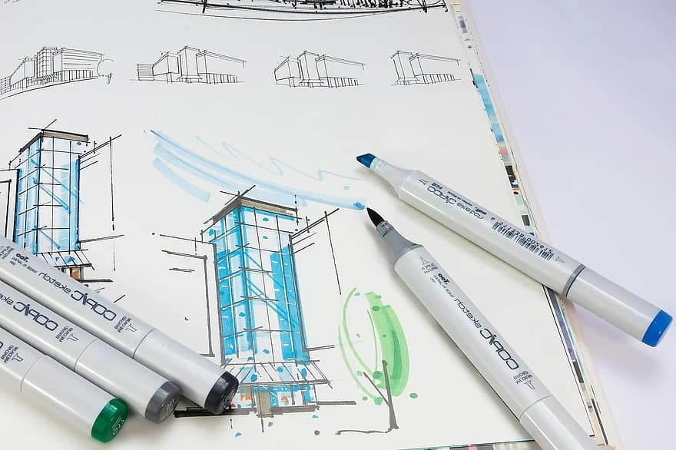
Development Concepts & Renderings
The City has developed a series of development concepts and renderings for Downtown Rohnert Park
Layouts illustrate arrangements of land uses that are also consistent with the Downtown Form Based Code
Site maps are not intended to limit the creativity of development teams
Meant to illustrate the work the City has completed and represent the vision of what a Downtown Rohnert Park could look like

Slide 30
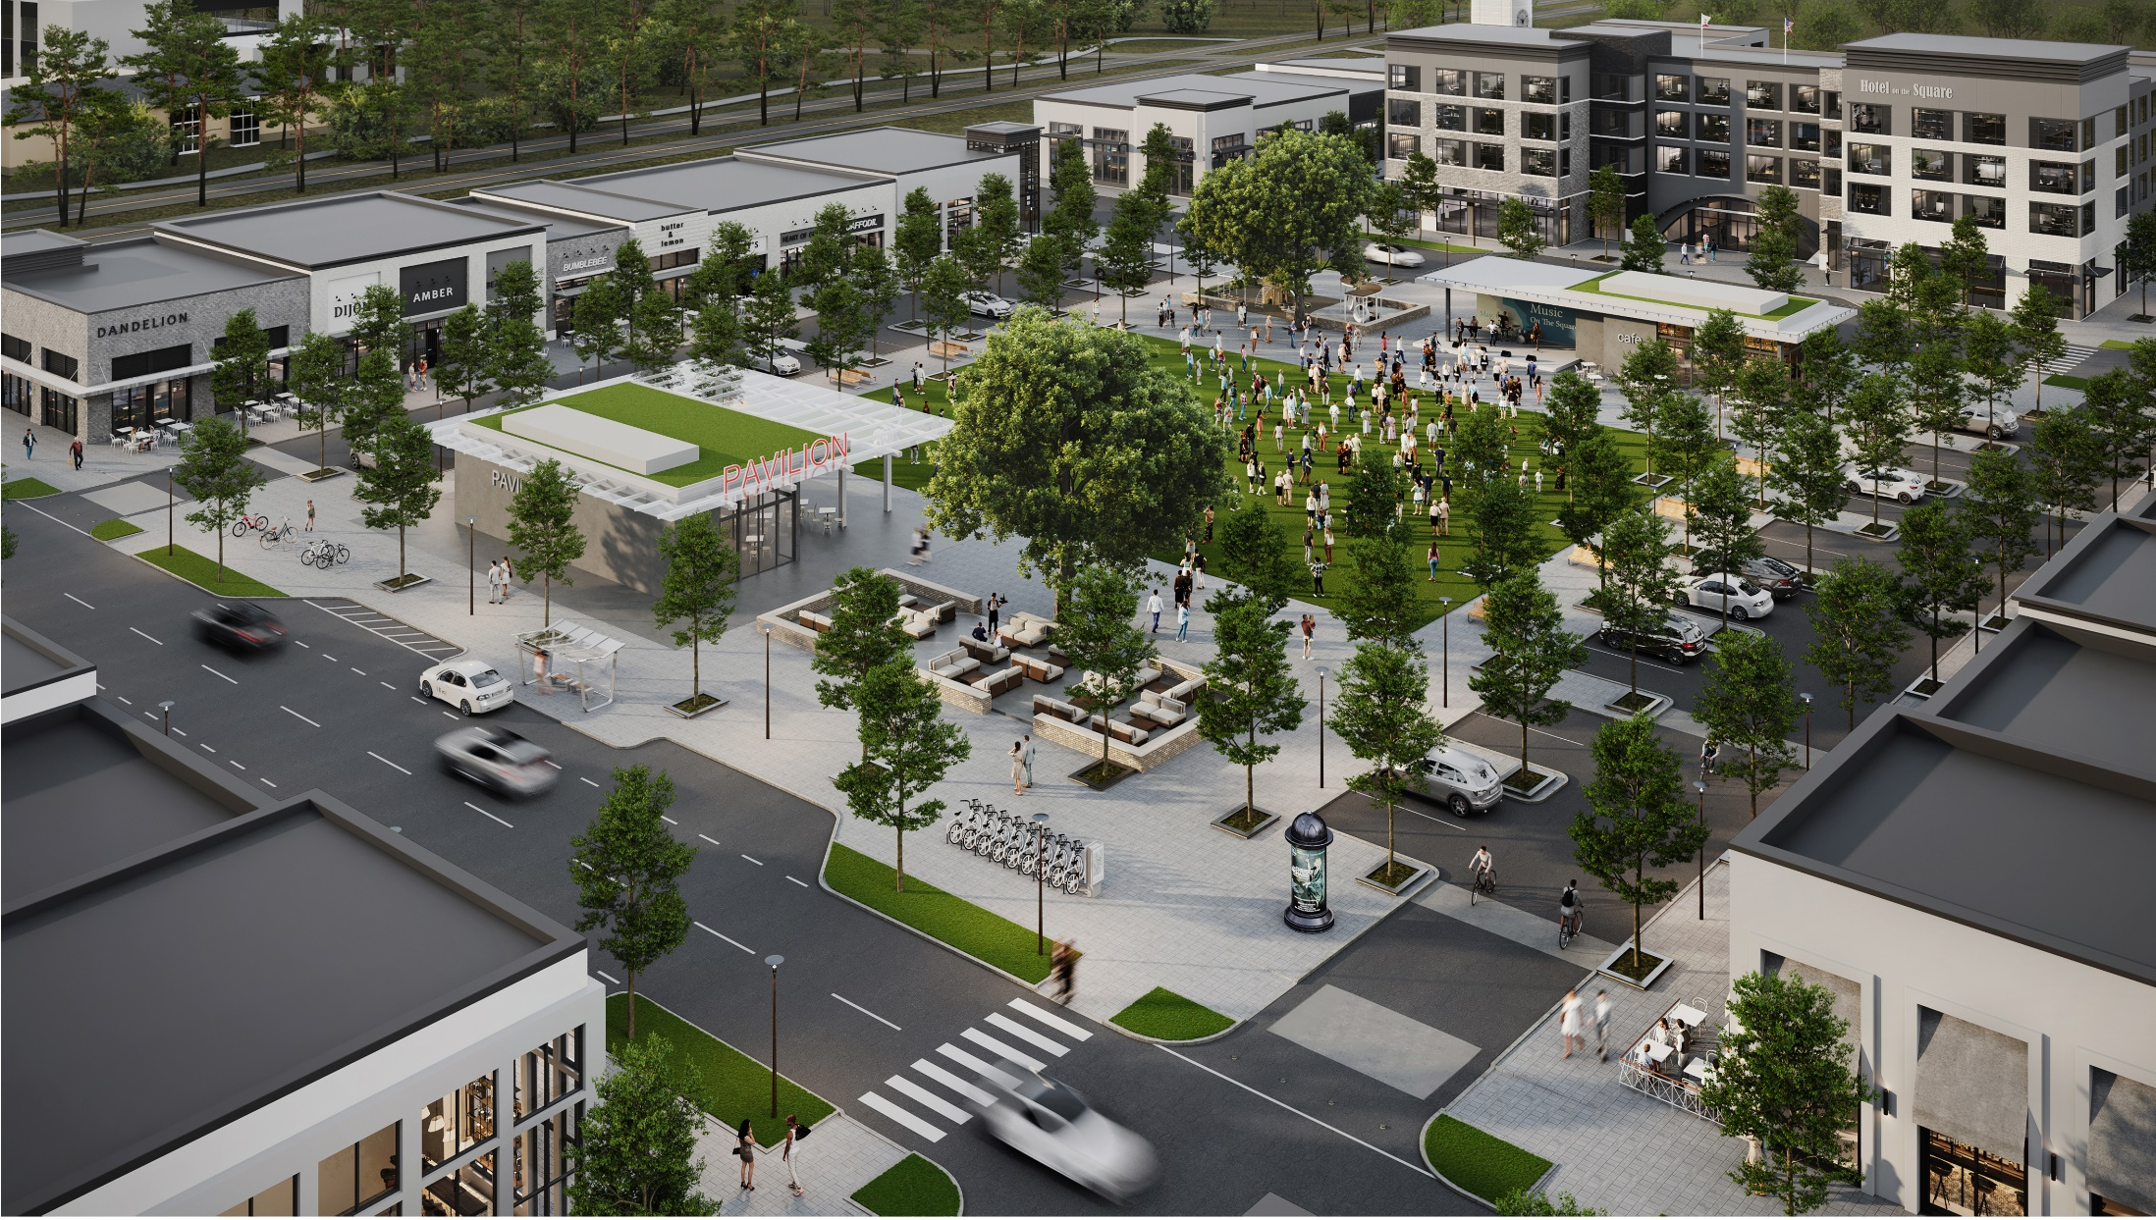

The Community Square
“Music on the Square”
CONCEPTUAL

Slide 31
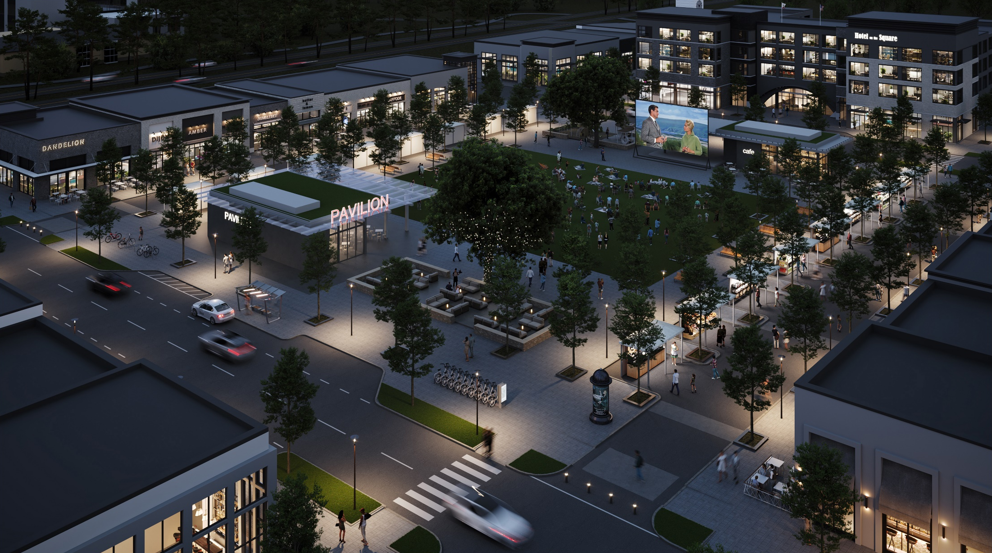
The Community Square
“Movie Night and Evening Farmer’s Market”
CONCEPTUAL

Slide 32
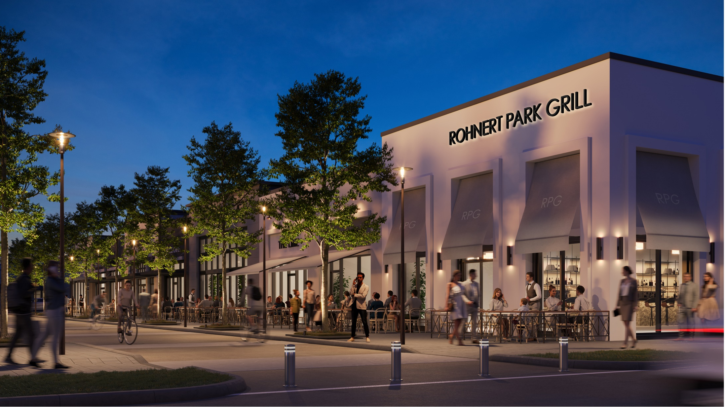
The Retail Core
“Sidewalk seating at the Grill”
CONCEPTUAL

Slide 33
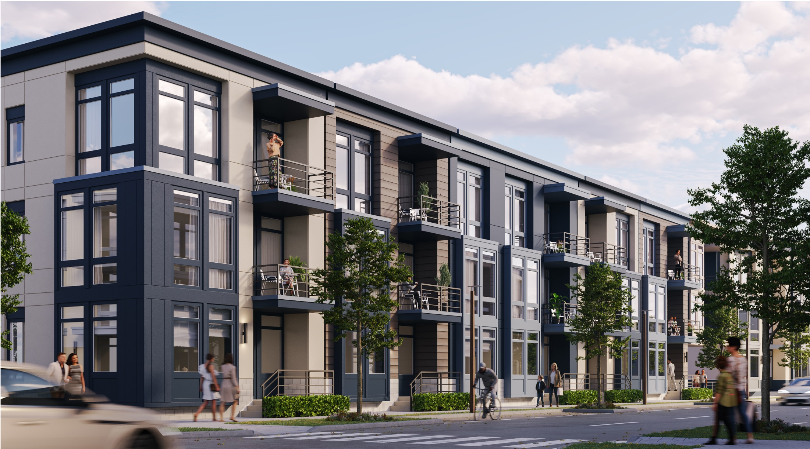
Residential View
“Downtown living”
CONCEPTUAL

Slide 34
Proposed RFQ Schedule
11/1/2023
Downtown RFQ Issued
11/30/2023
1/22/2024
12/21/2023
1/8/2024
March/April 2024
April/May 2024
May/June 2024
On-site Mandatory Project Introduction Meeting
Deadline for RFQ Questions
RFQ Questions Addendum Released
RFQ Closes
Interviews with selected developers
Site visits to developer project sites
Potential selection of developer
January/February 2024
City Review of Developer Qualifications

Slide 35
Conclusion
Goal: Develop a vibrant transit-oriented, mixed-used community for generations to enjoy!
Establish a public-private partnership with an experienced and financially capable developer(s)
Remain flexible with conceptual site plan
Coordinate naming of project with selected developer
Research and procure funding opportunities
Release RFQ by no later than November 1, 2023
Select developer by no later than June 2024

Slide 36

Questions?

Slide 37
Meeting Questions/Topics/Notes
Can we examine better speed control options on Lancaster Dr?
Can we examine a better crosswalk at the 4-way stop at Lancaster Dr/Liman Way?
What can we do about the SOMO Development and the preservation of the wetlands?
Is there a way to limit the height of the SOMO development?

